Slide 1

WPF4
Jaime Rodriguez
Senior Technical Evangelist
http://blogs.msdn.com/jaimer
Microsoft Corporation

Slide 2
Session Objectives
Give you a good understanding of what’s in WPF4.0
What is coming
When it will come

Slide 3
Lots of Good Stuff
Cached compositions
Textclarity
Layout rounding
ClickOnce improvements
Multitouch
Windows 7 taskbar
Windows 7 ribbon
Focus mgt improvements
Support for UIAccessible2
VSM integration
Full Trust XBaps
Media element improvements
Client profile
Data controls
Accessibility improvements
Control themes
Chart controls
Hundreds of good bug fixes too
Plus all the new goodness of .NET Framework 4!
Dynamic language support
Mef
Globalization and NLS improvements
Managed/native code interop
F#
More…

Slide 4
WPF4
Windows 7
Fundamentals
Features for larger apps (like VS…)
Tooling and workflow

Slide 5
travelSuru
demo

Slide 6
WPF for Windows 7 Rapid Application Development on Win7 Innovations
Multi-Touch
Taskbar
Ribbon
Common dialogs
File Explorer presence and customization
More…
Use these with .NET and via XAML in WPF

Slide 7
Multi-Touch in WPF
UIElement changes
Manipulation events (tracking and interpreter)
Touch system gesture events (double-tap and rollover)
Raw touch input events (for going to the metal)
Multi-touch support in controls
ScrollViewer update to accept pan gestures
Base controls updated to be multi-touch aware
Multi-capture support (for more than one contact point at time)
New multi-touch specific controls (e.g. ScatterView)
Compatible with Surface SDK 2.0

Slide 8

Touch Development Roadmap
NET 4.0 / Surface 2.0 Release
Windows 7 Release
Native
Win32
Application
WinFormsApplication
WPF Application
Surface Application
Surface SDK
1.0
Surface SDK 2.0
Multi-Touch Controls
Surface
Multi-Touch Controls & API
Multi-Touch API
WPF 3.5 SP1
Managed Wrapper and Interop
WPF 4.0
Managed Wrapper and Interop
WPF 3.5
Multi-Touch API and Controls
Surface Hardware
Windows 7
Windows 7
Surface Hardware
Windows Vista
Multi-Touch API

Slide 9
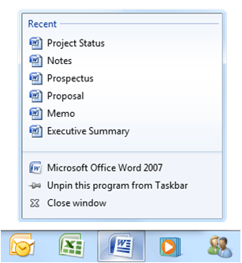
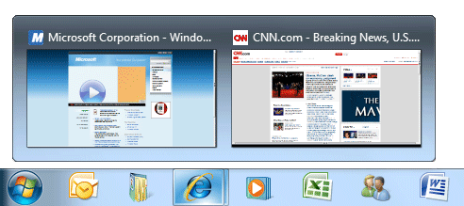
WPF Taskbar Integration
Thumbnails toolbars
Icon overlays
Progress bars
Jumplists
With XAML Support

Slide 10
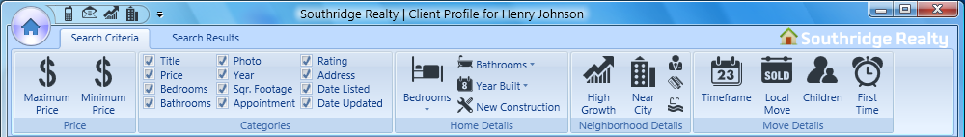
WPF Ribbon
Features
Fulfills office fluent UI licensing requirements
Ribbon with resizing and layout behavior
Ribbontabs
Ribbongroups
Ribbonapplicationmenu (Pearl)
Quickaccesstoolbar
Keytips
Design time support

Slide 11

WPF Tooling Improvements
Visual Studio
Designer
Blend3
RAD databinding
Easier autolayout
Markup extension intellisense
More property editors
Improvements to XAML authoring and workflow
VSM
Behaviors
Transition animations
Prototyping tools

Slide 12
"Cider"
demo

Slide 13
Fundamentals
Framework deployment
Application deployment
Improved interop
Text clarity
Layout rounding/snapping
Media improvements
UIA – for accessibility and TFS
Graphics performance
Localization

Slide 14
Graphics
Composition API - give application authors fine grained control over caching rendered elements in video memory
An input to a shader effect
An image brush to fill any arbitrary 2D shape
A texture on a 3D model

Slide 15
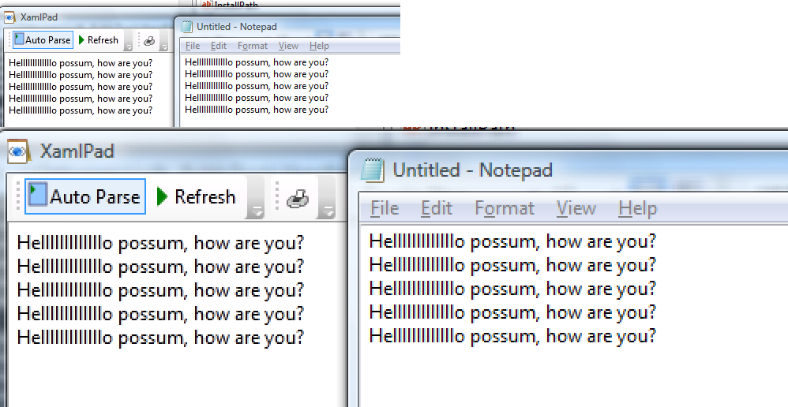
WPF 4.0 <left> versus GDI <right>

Slide 16
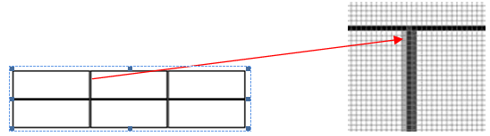
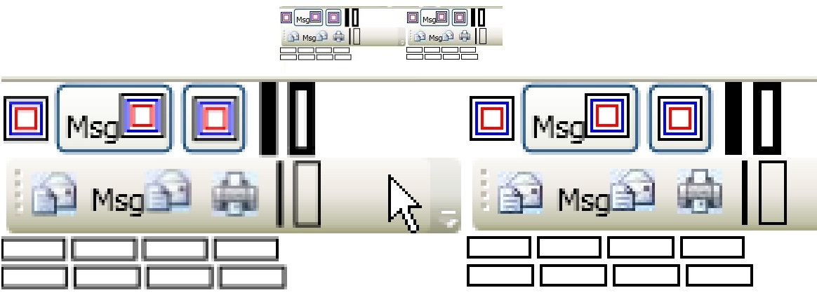
Layout Rounding
Rounds an object’s coordinates on whole pixels
UseLayoutRounding="True"

Slide 17
Framework Deployment
.NET 4 is a Side by Side release!
Visual Studio and .NET support multi-targeting
Client profile SKU
Setup improvements

Slide 18
Client Profile SKU
Smaller, Faster NET Framework SKU
.NET Framework Client Profile22mb
Setup optimizations for ngen, download, etc.
Works across ALL CONFIGURATIONS
Brandable deployment experience
Developers can customize app deployment experience to match brand
Can integrate framework and app installers
Tools and documentation for creating these packages
Easier deployment of applications
Developers may use deployment bootstrapper to manage the installation of their app and pre-reqs
Will install application after the framework and launch it (.msi, .application or .xbap)

Slide 19
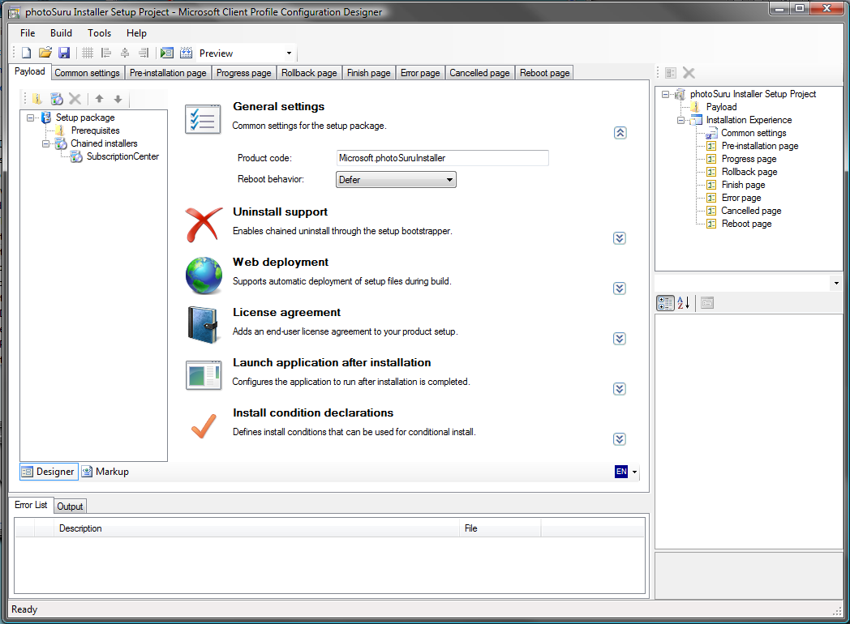
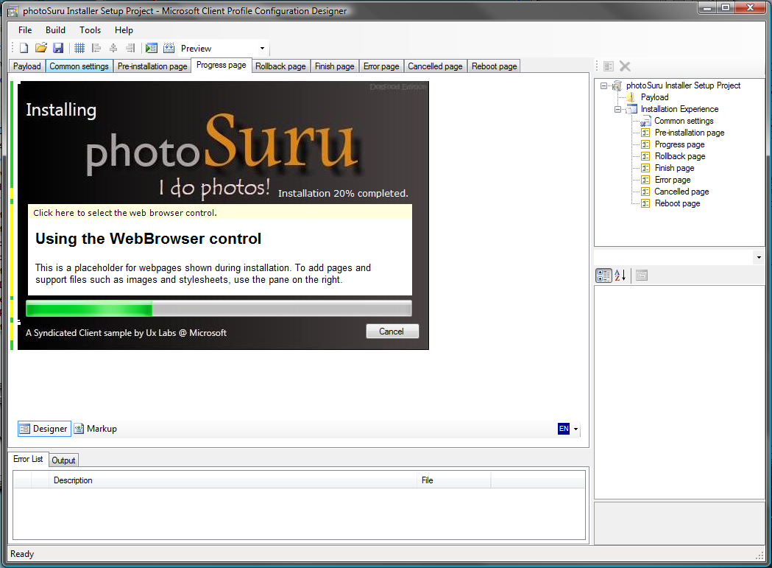
Client Profile Configurator Tool
Configurator tool http://www.codeplex.com/wpf/Release/ProjectReleases.aspx?ReleaseId=14962
Client profile Configuration designer “How To” series
http://windowsclient.net/wpf/wpf35/wpf-35sp1-start-here.aspx

Slide 20
Application Deployment
Continuing to make improvements to ClickOnce to enable a more seamless install and upgrade experience
3.5 and SP1
Command-line arguments for CO deployed apps
File associations for CO deployed apps
CO support for FireFox
4.0
Background updates and custom install ux

Slide 21
Controls
WPF4
DataGrid
DatePicker
VSM
Future
Chart Controls
More…

Slide 22
Time-lines
Beta1
XAML Compiler
Multi-Touch:
Input, Inertia, Panning
Easing functions
Beta2
Cached Composition
Direct Write
Windows 7 taskbar
Multi-Touch:
Controls, Surface.
VSM
Layout rounding

Slide 23
WPF4 and VS10
Best way to take advantage of Windows 7
Solid fundamentals: Deployment and ubiquity, text clarity, interop, performance, controls, and completeness
Much improved tooling and designers with VS10 and Blend3
Do
Download the beta, demos and give us feedback

Slide 24


Your Questions
?
?
?
?
?
?

Slide 25
Please Complete an Evaluation Form Your feedback is important!
Evaluation forms can be found on each chair
Temp Staff at the back of the room have additional evaluation form copies

Slide 26

© 2009 Microsoft Corporation. All rights reserved. Microsoft, Windows, Windows Vista and other product names are or may be registered trademarks and/or trademarks in the U.S. and/or other countries.
The information herein is for informational purposes only and represents the current view of Microsoft Corporation as of the date of this presentation. Because Microsoft must respond to changing market conditions, it should not be interpreted to be a commitment on the part of Microsoft, and Microsoft cannot guarantee the accuracy of any information provided after the date of this presentation. MICROSOFT MAKES NO WARRANTIES, EXPRESS, IMPLIED OR STATUTORY, AS TO THE INFORMATION IN THIS PRESENTATION.

